Slide 1

Indian Agriculture
Marwa
Ashraf

Slide 2
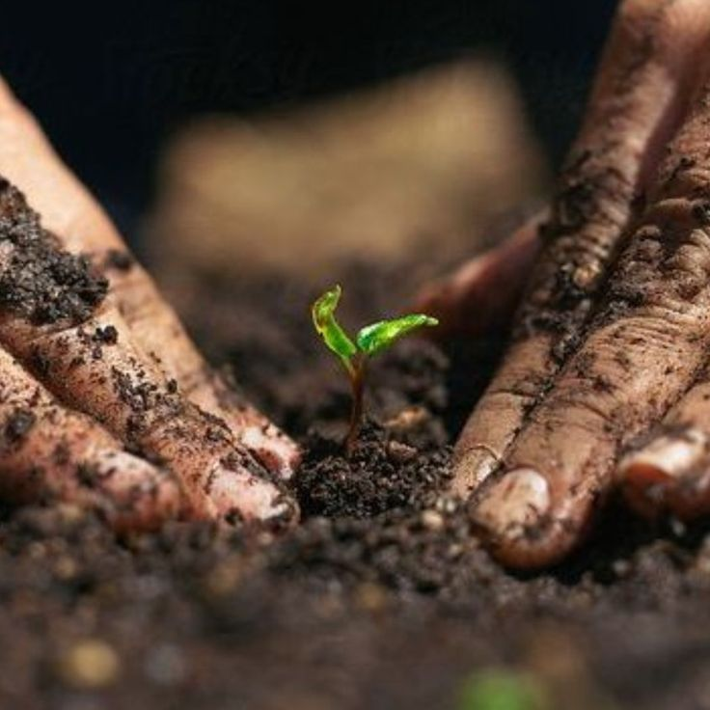

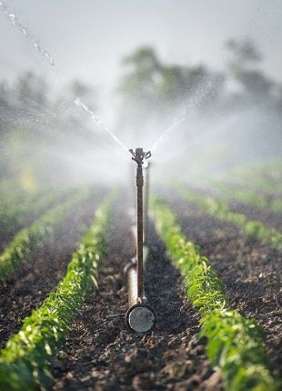

Agenda
Introduction
Import Data
Transformation Data
Data Modeling
Visualization

Slide 3


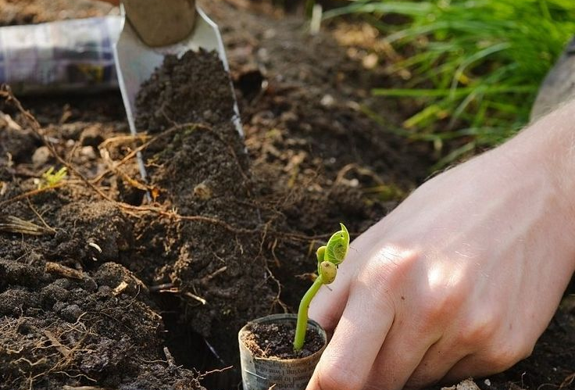
Introduction
District-wise agricultural data for 20 major crops in India, including area, yield, and production, are provided, enabling detailed analysis of productivity trends. The dataset encompasses both traditional crop varieties and High Yielding Varieties (HYVs), offering insights into modern agricultural practices. With detailed documentation, it ensures clarity and accuracy in analysis. This valuable resource aids policymakers, researchers, and stakeholders in understanding localized agricultural dynamics and optimizing interventions. It serves as a comprehensive tool for evidence-based decision-making and strategic planning in India's agricultural sector.

Slide 4
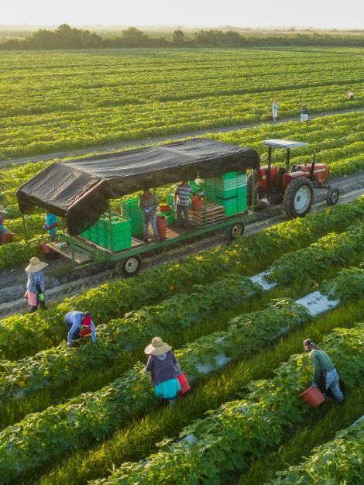
Import Data
Power BI

Slide 5
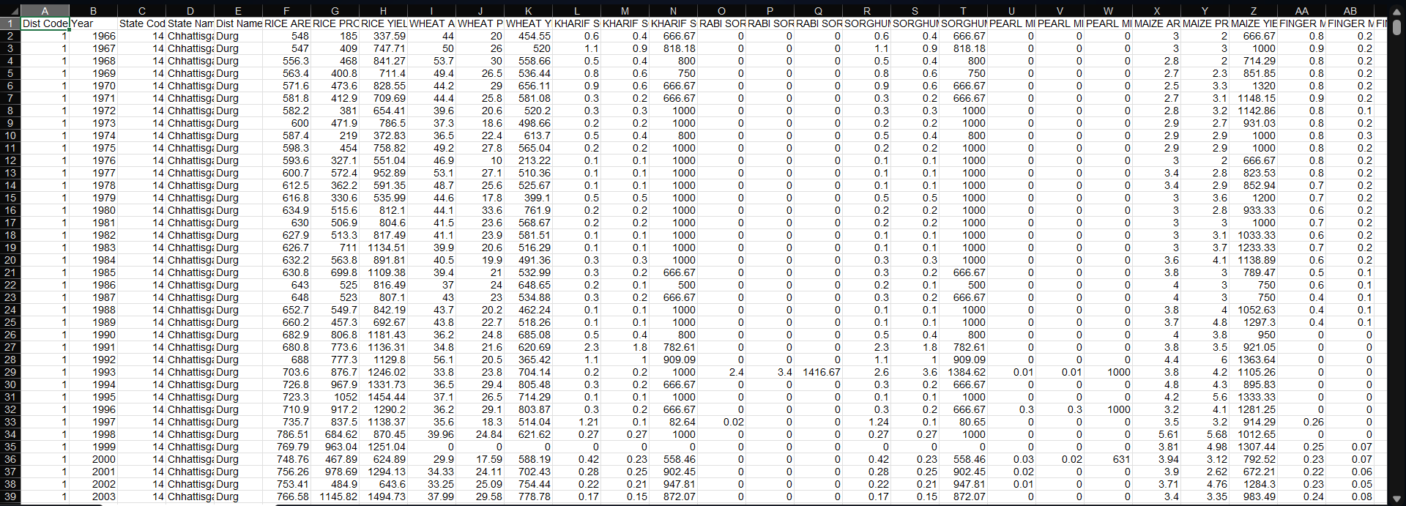
Data Overview

Slide 6
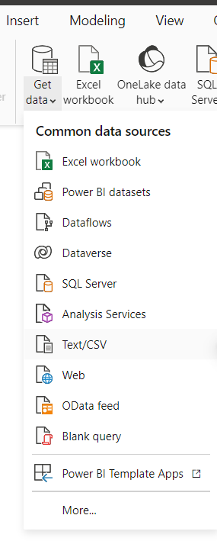
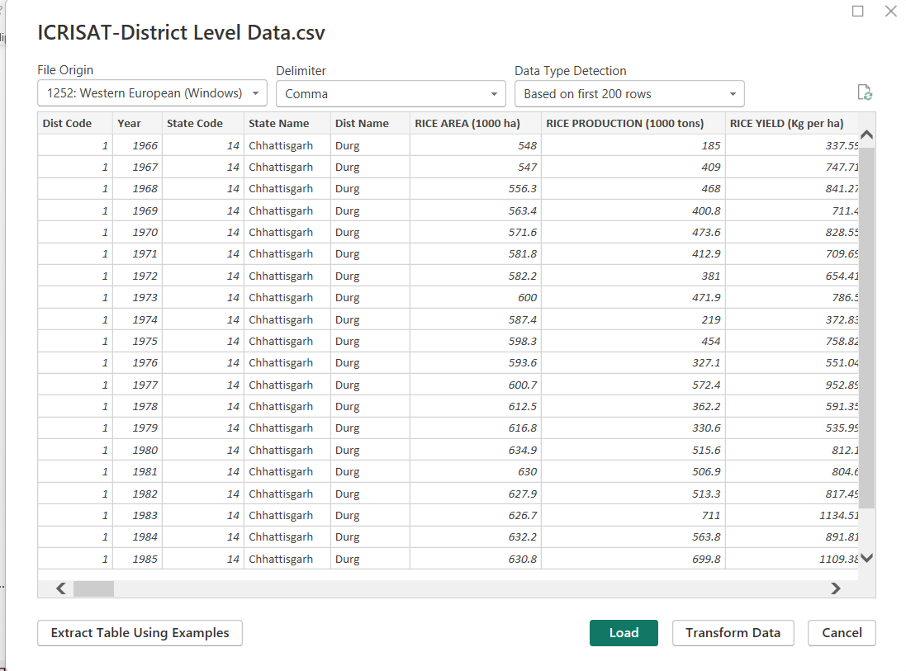
Import Data From CSV to Power BI
Power BI
6

Slide 7
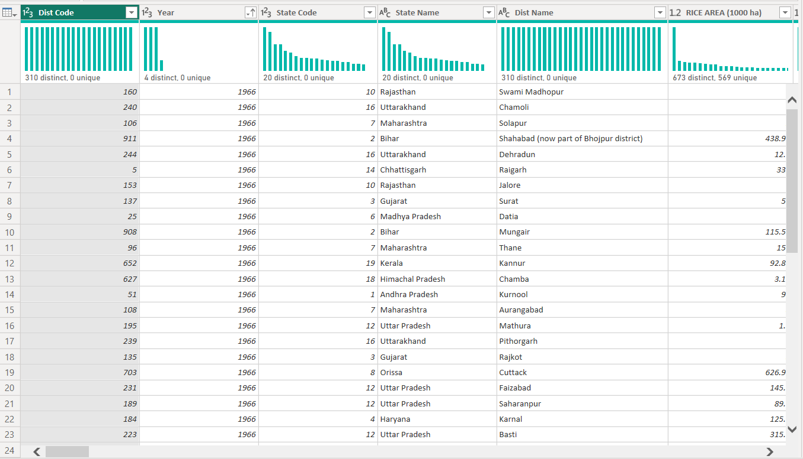
Transform Data into Power Query
7

Slide 8
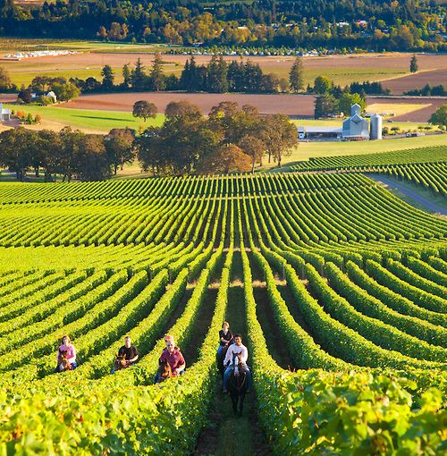
Transformation Data
Power BI

Slide 9
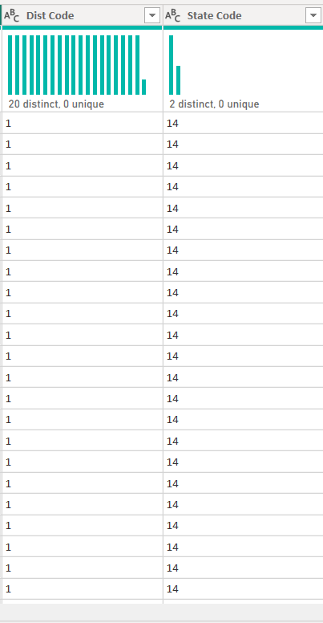
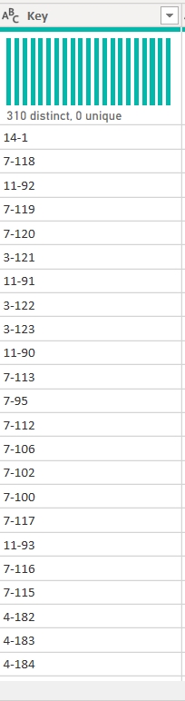
Merge District Code and State Code To make a Key and Replace Negative Value With Positive same Value

Slide 10
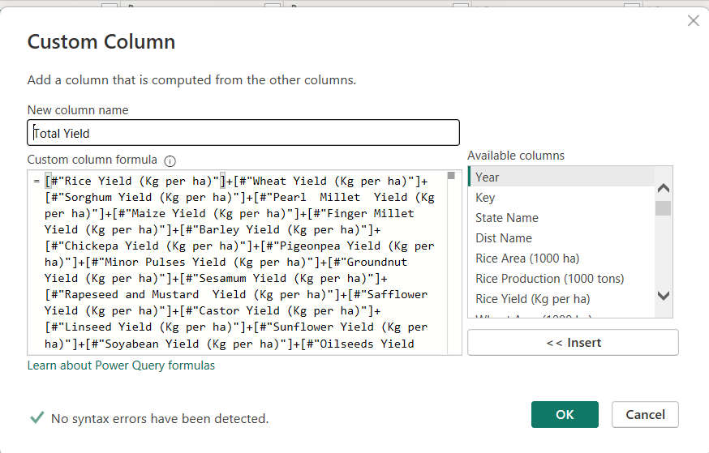
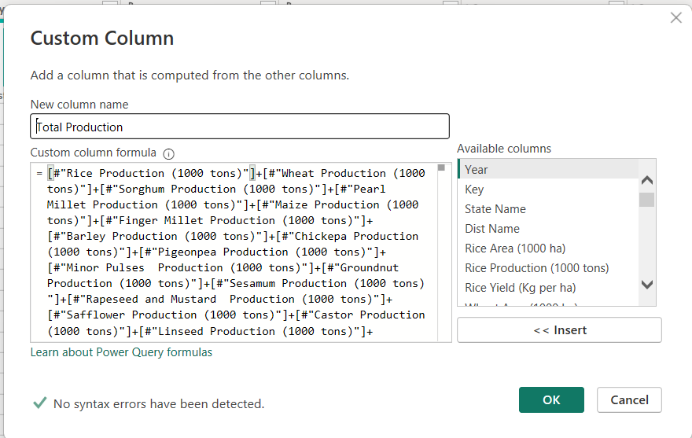
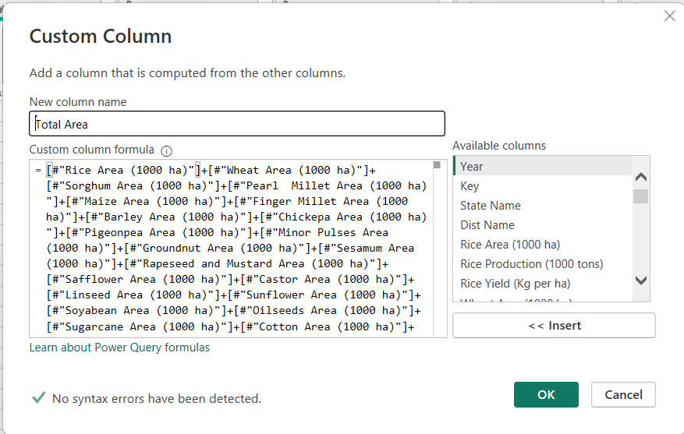
Add Custome Columns Total Area , Production , Yield

Slide 11
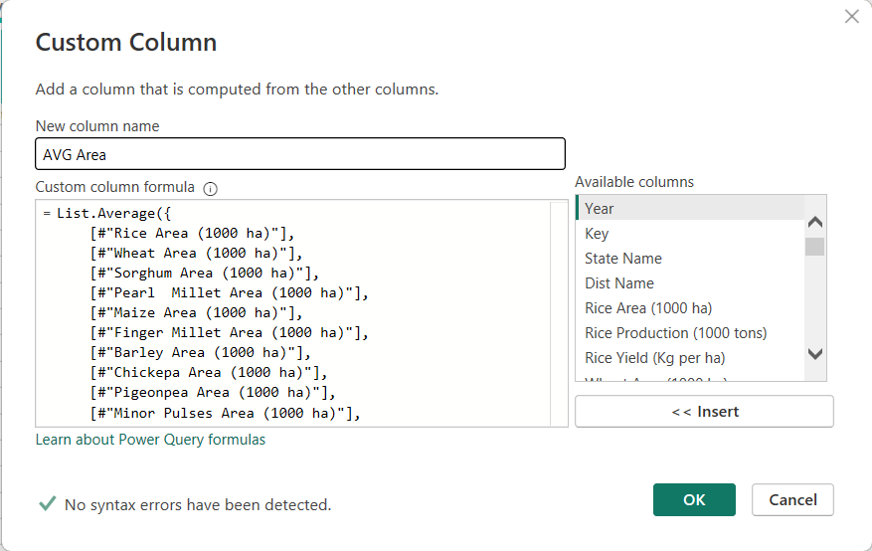
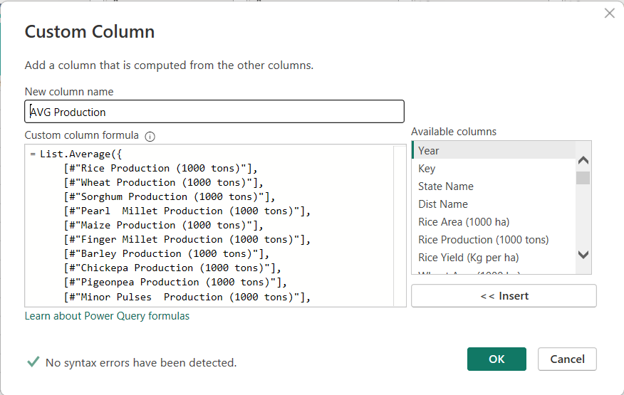
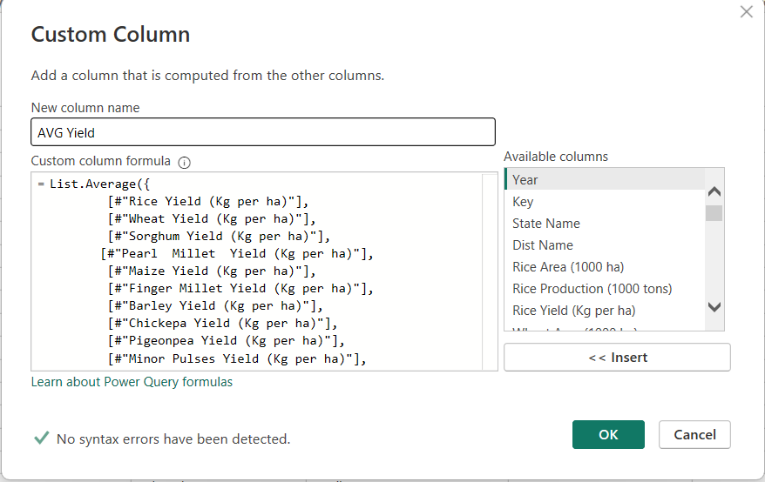
Add Custome Columns Average Area , Production , Yield

Slide 12
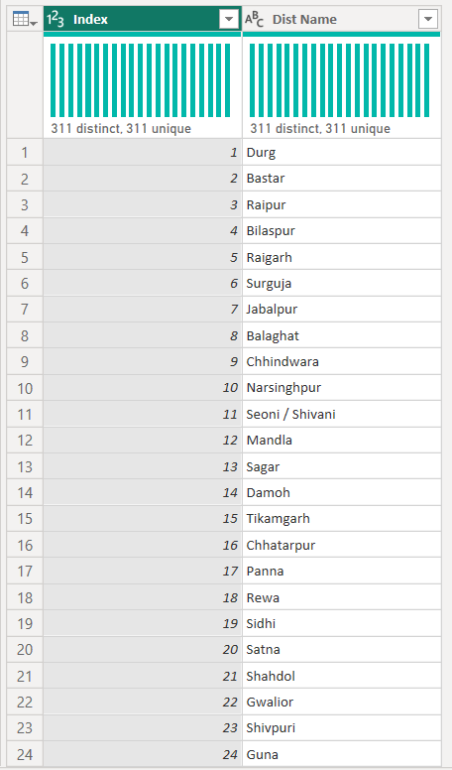
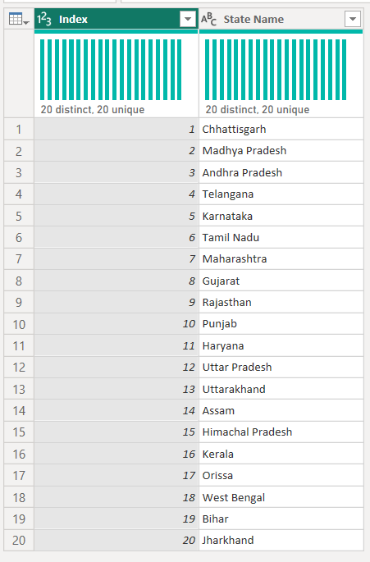
Create Table State With Distinct State Name and Table District with Distinct District Name

Slide 13
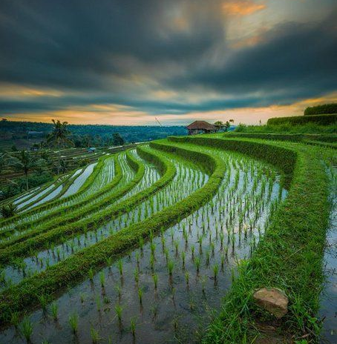
Data Modeling
Power BI

Slide 14
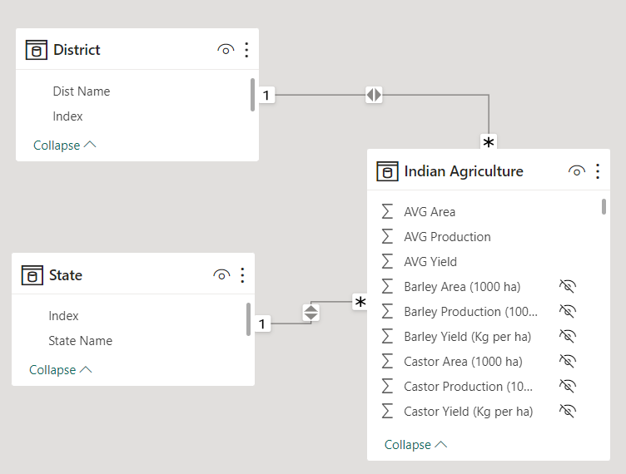
Data Model of Indian Agriculture Dataset

Slide 15
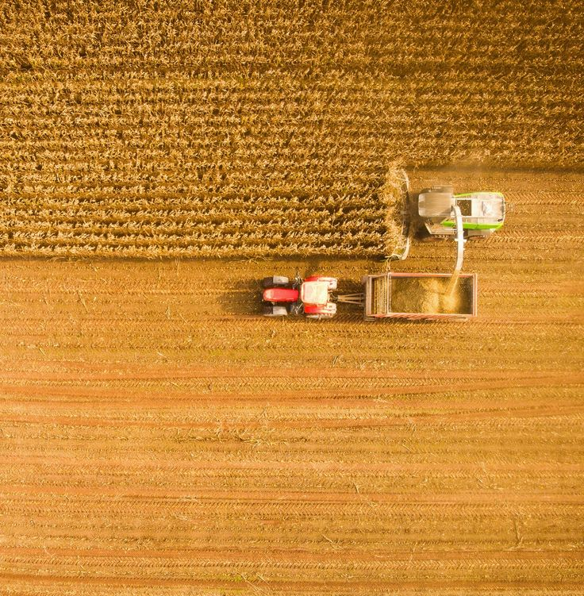
Data Visualization
Power BI

Slide 16
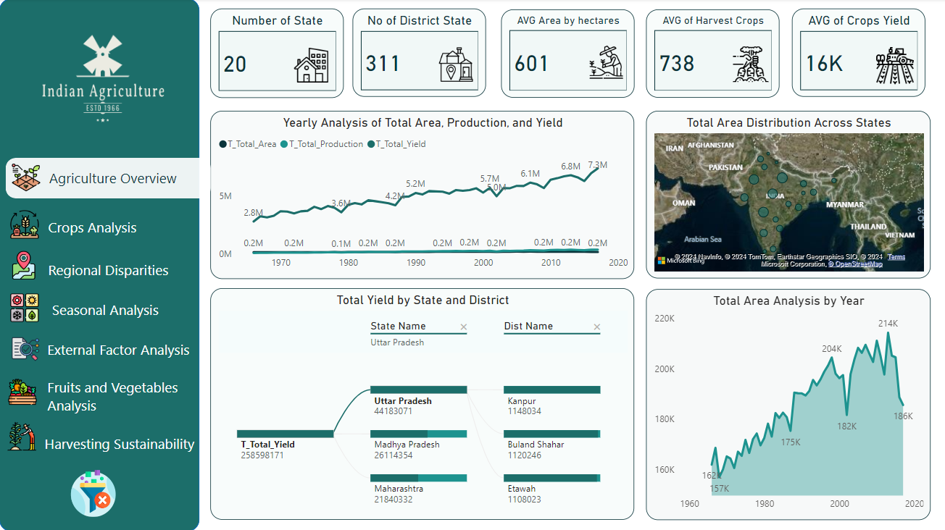
Agriculture Overview

Slide 17
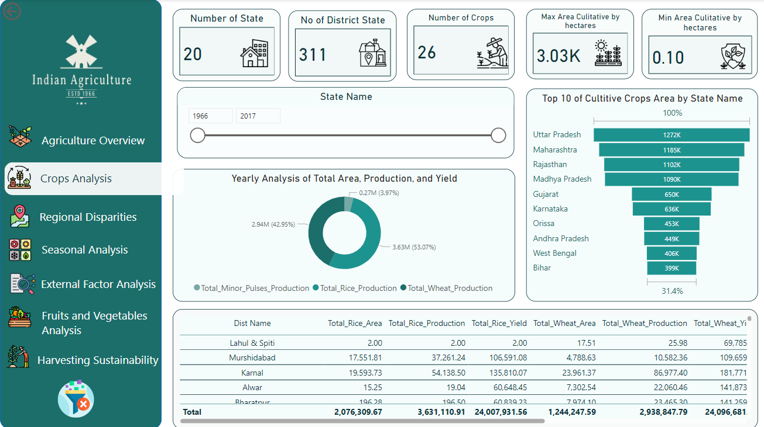
Crops Analysis

Slide 18
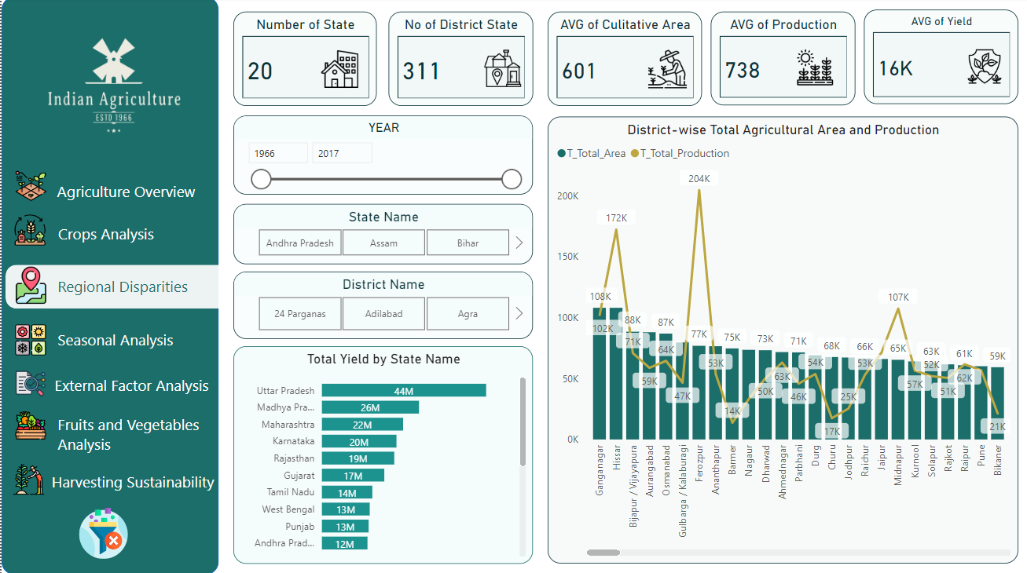
Regional Disparities

Slide 19
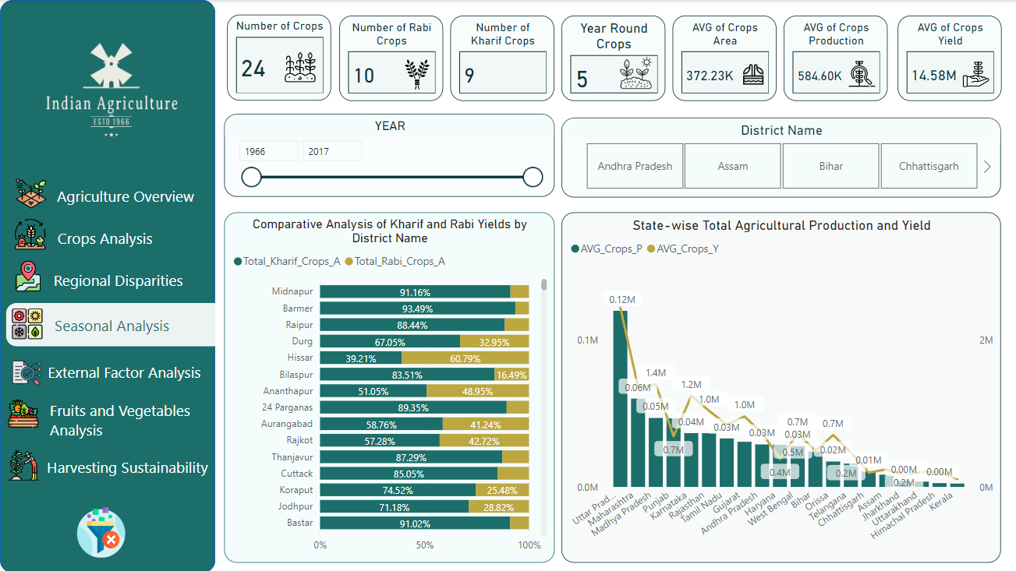
Seasonal Analysis

Slide 20
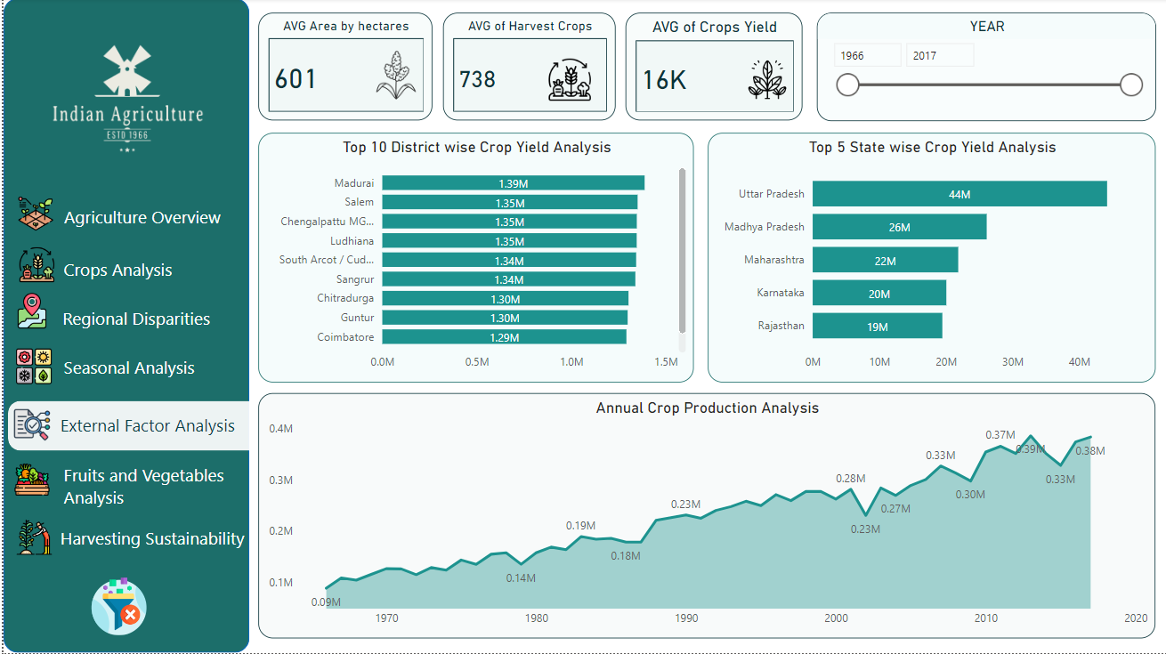
External Factor Analysis

Slide 21
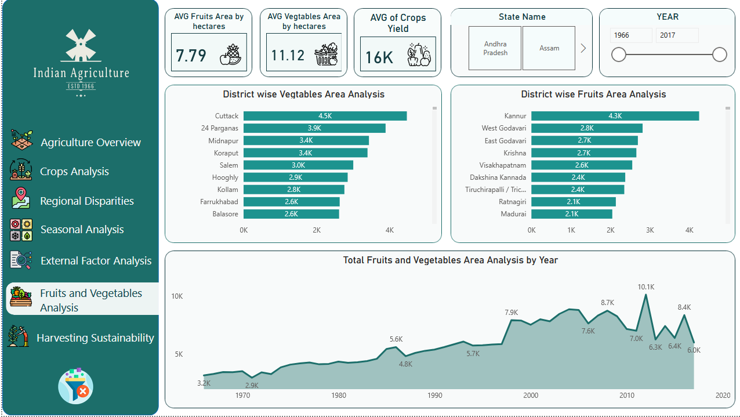
Fruits and Vegetables Analysis

Slide 22
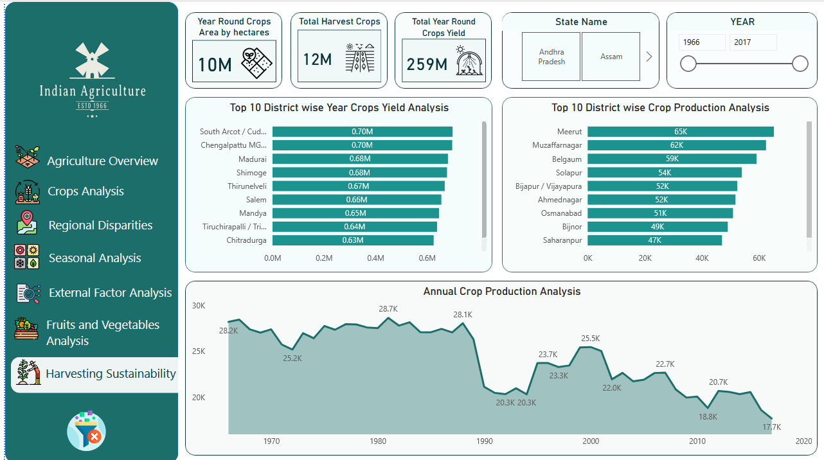
Harvesting Sustainability

Slide 23

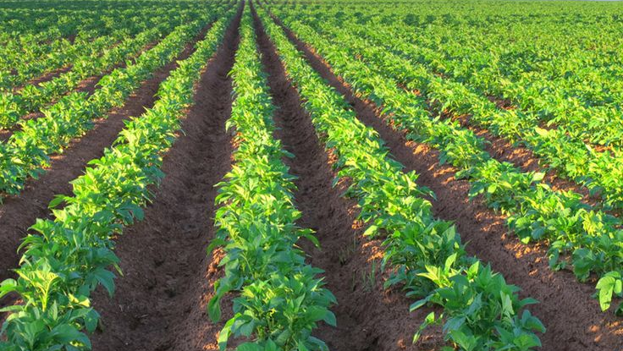
Summary
"Through advanced data analysis techniques, valuable insights can be gleaned from agricultural data, enabling optimization of crop yields, resource allocation, and pest management strategies. By leveraging data-driven approaches, farmers can make informed decisions to enhance productivity, sustainability, and resilience in their operations."

Slide 24
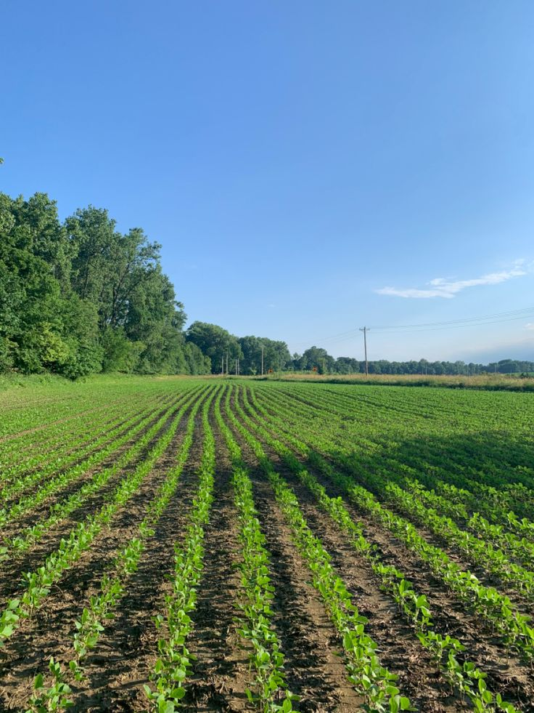
Thank you
Marwa Ashraf
marwaashraf5814@gmail.com
https://www.novypro.com/project/indian-agriculture

